Slide 1

Enzyme-Constrained GEMs of microbial and human metabolism
PhD student Iván Domenzain 2019-10-10

Slide 2
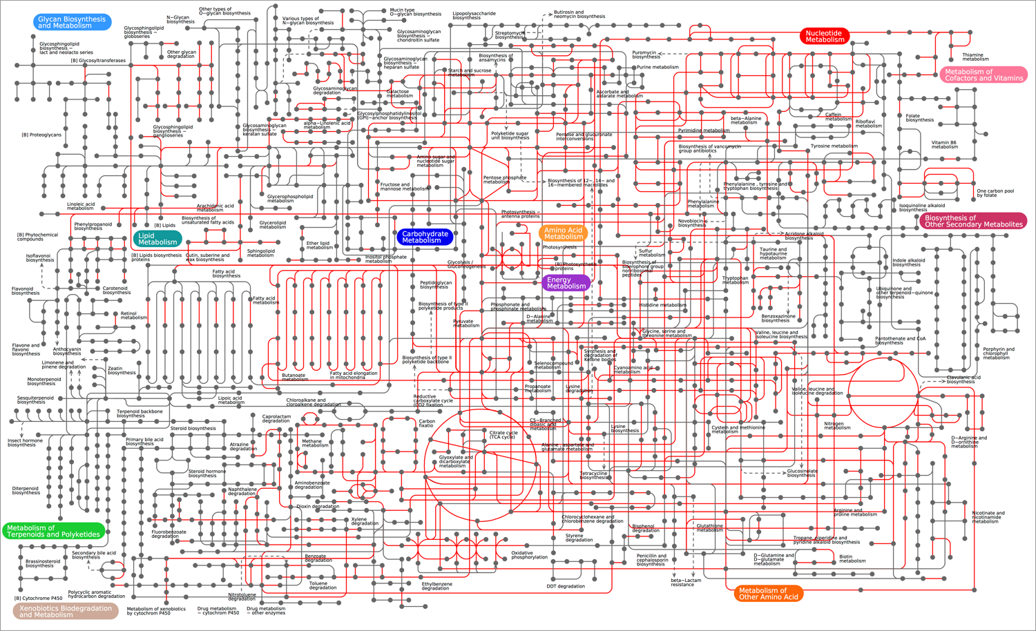
Enzyme limitations in metabolism
Metabolism:
At the core of cellular function
Huge
Highly constrained
Enzyme limitations:
Each metabolic reaction is limited by its corresponding enzyme
Enzymes have different catalytic activities → pathways will have different limitations
We want to model them!

Slide 3
Enzyme limitations in metabolism
Not all pathways have the same limitations!!

Slide 4
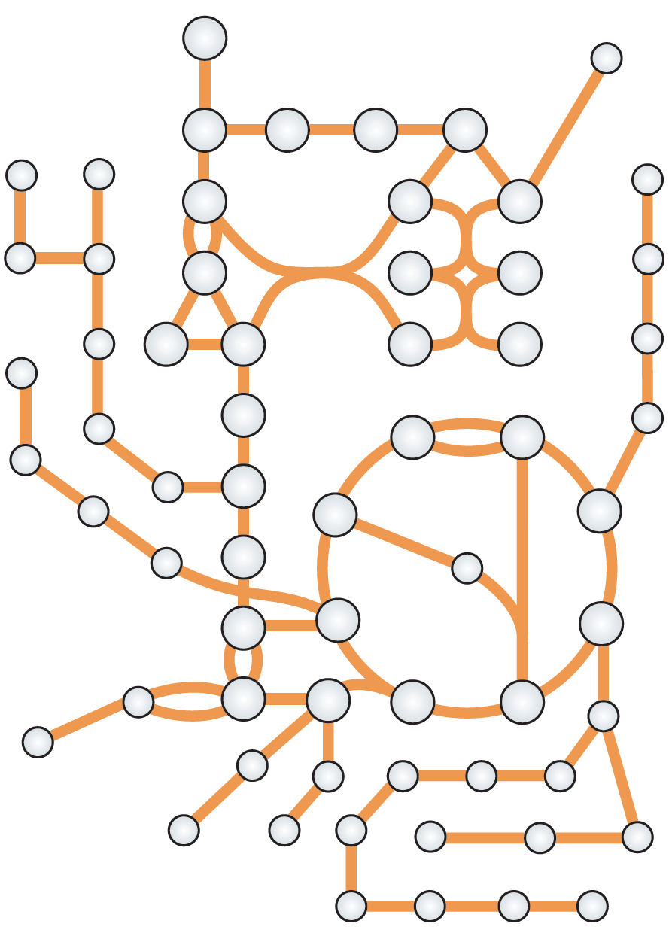
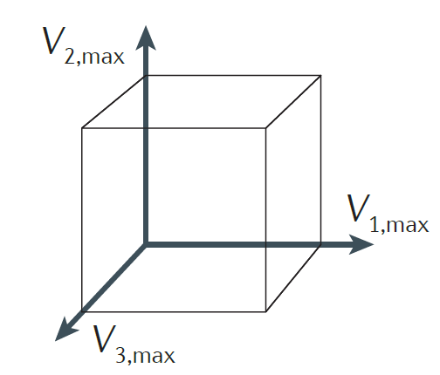
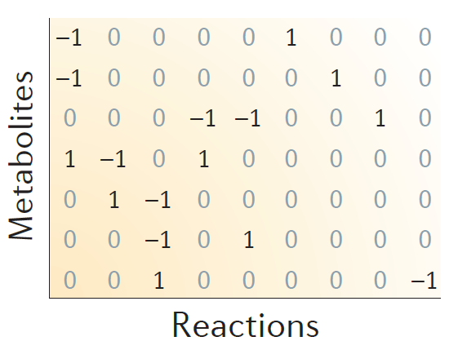
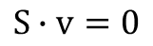
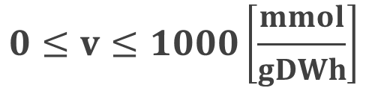
Modeling metabolism
3 easy steps to create a GEnome-scale Model (GEM) of metabolism:
1. Get network
2. Construct stoichiometric matrix (S)
3. Define constraints
$$S∙v=0$$
Some fluxes can be measured experimentally (i.e. exchange fluxes), but for most of them we assume:
$$0≤v≤1000\left[\frac{mmol}{gDWh}\right]$$
Is this realistic?
Notes:
~1000 people/door s

Slide 5
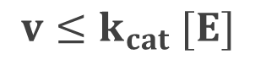
Modeling enzyme limitations in metabolism
Relationship between enzyme and reaction:
Flux of reaction
[mmol/gDWh]
$$v≤k_{cat} [E]$$
Concentration of enzyme [mmol/gDW]
Turnover number [1/h]

Slide 6
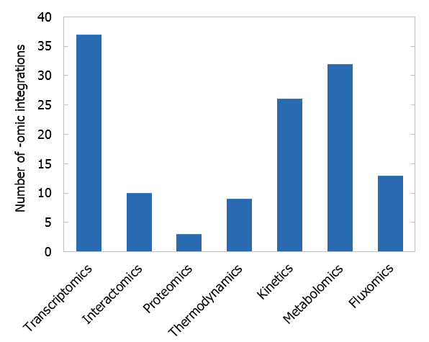
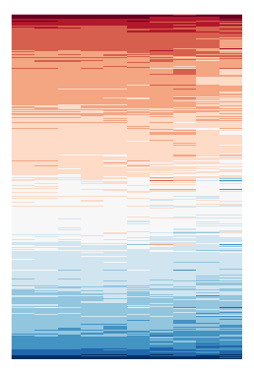
Modeling enzyme limitations in metabolism
Relationship between enzyme and reaction:
Flux of reaction
[mmol/gDWh]
$$v≤k_{cat} [E]$$
Concentration of enzyme [mmol/gDW]
Turnover number [1/h]
However: No available method for directly connecting proteomics to GEMs
Proteomics
Metabolism
Sánchez, B. J., & Nielsen, J. (2015). Integrative Biology, 7(8), 846–858. https://doi.org/10.1039/c5ib00083a

Slide 7
Taking enzymes into account
Nilsson, A., & Nielsen, J. (2016). Scientific Reports, 6. https://doi.org/10.1038/srep22264

Slide 8
Taking enzymes into account
Nilsson, A., & Nielsen, J. (2016). Scientific Reports, 6. https://doi.org/10.1038/srep22264

Slide 9


Taking enzymes into account
Reproducing the Crabtree effect
Metabolic efficiency
(low substrate)
5 GLU + 30 O₂
100 ATP + 30 CO₂
~240 mg of protein
Catalytic efficiency
(Low enzyme)
50 GLU
100 ATP + 100 ETH + 100 CO₂
~120 mg of protein

Slide 10
Going into Genome-Scale

Slide 11

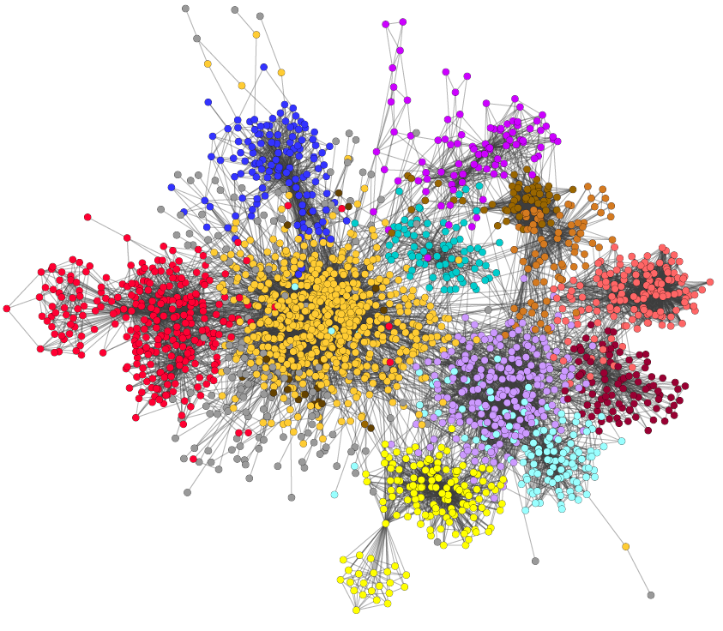
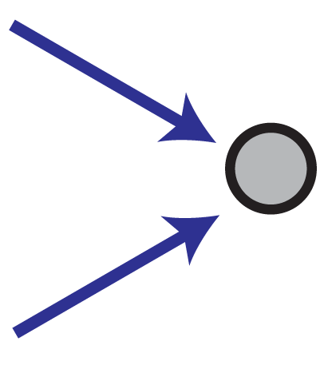


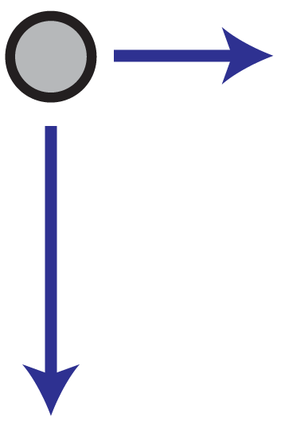
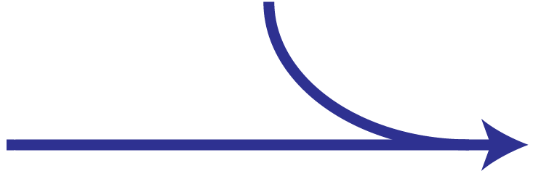

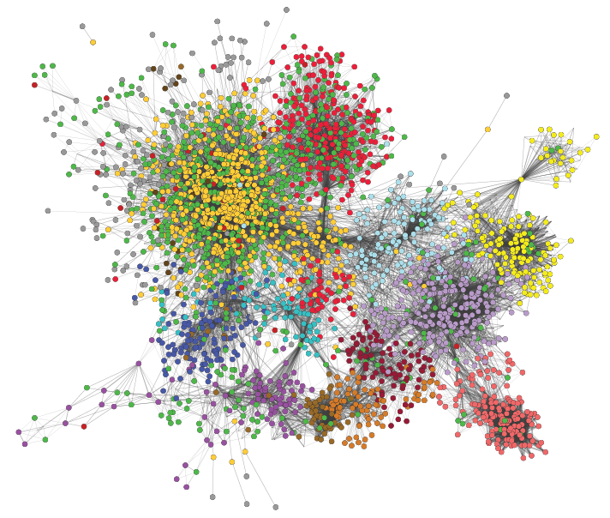

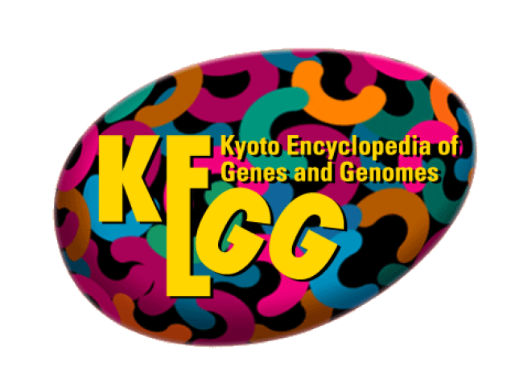


Metabolic model (GEM)
Enzyme usage: e
[mmol/gDW]
e ≤ [E]
E
Enzyme-constrained model
Enzyme data
A
B
Flux: v [mmol/gDWh]
Proteomics
(optional)
New stoichiometry: A + 1/k_{cat} E → B
Mass balance for E: v ≤ k_{cat} · [E]
Sánchez, B. J., Zhang, C., Nilsson, A., Lahtvee, P., Kerkhoven, E. J., & Nielsen, J. (2017). Molecular Systems Biology, 13(8), 935. https://doi.org/10.15252/msb.20167411

Slide 12
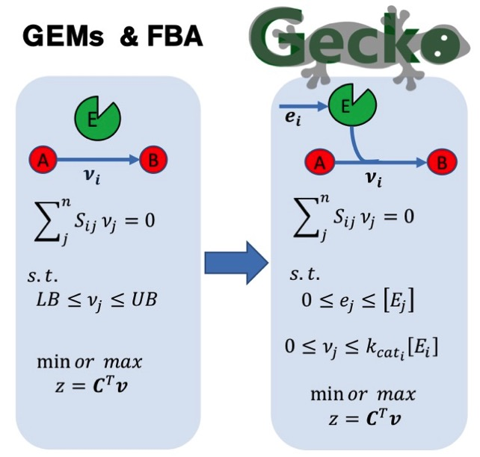
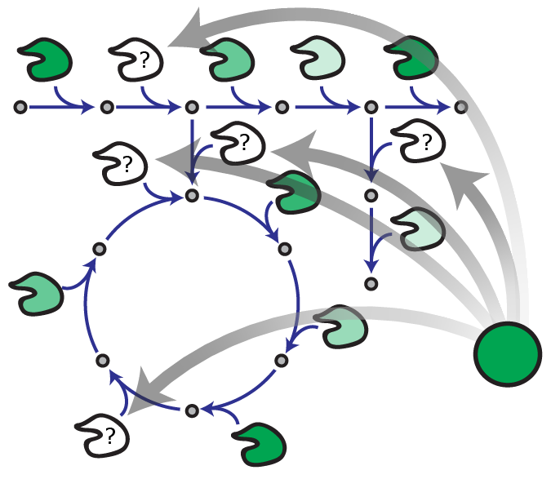
A simple mathematical framework

Slide 13
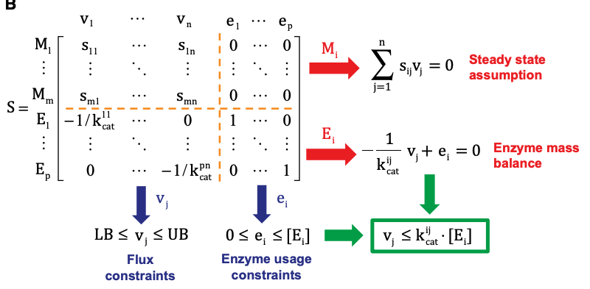
Matrix form

Slide 14
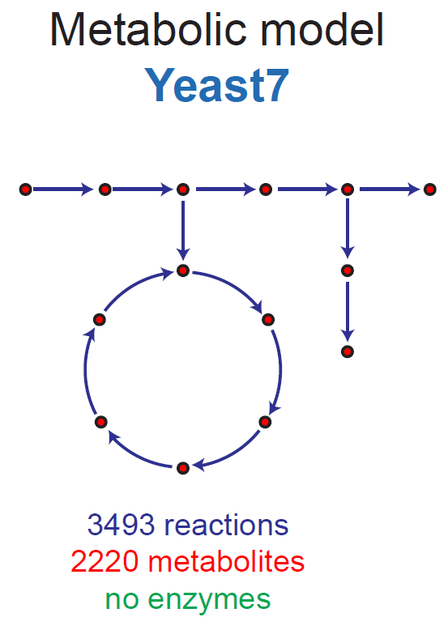
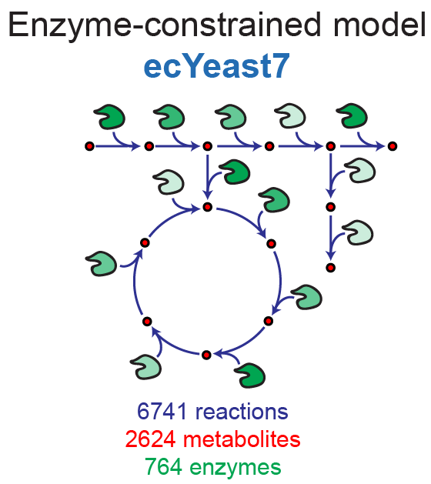

ecYeast7: an improved model of S. cerevisiae

Slide 15
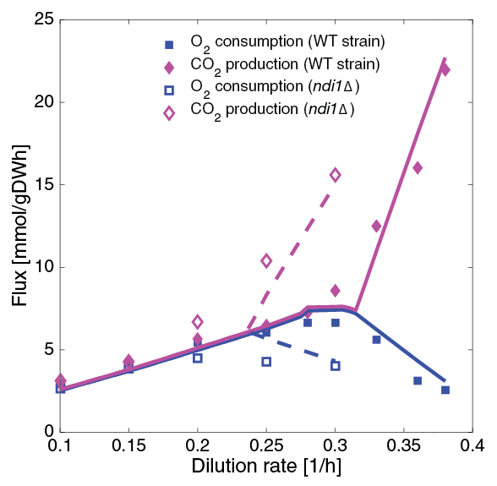
Improving phenotype predictions
Respiration/fermentation switch (in WT and knockout): chemostat simulations
Notes:
NDI1: Rotenone-insensitive NADH-ubiquinone oxidoreductase, mitochondrial.
NADH + ubiquinone = NAD⁺ + ubiquinol

Slide 16
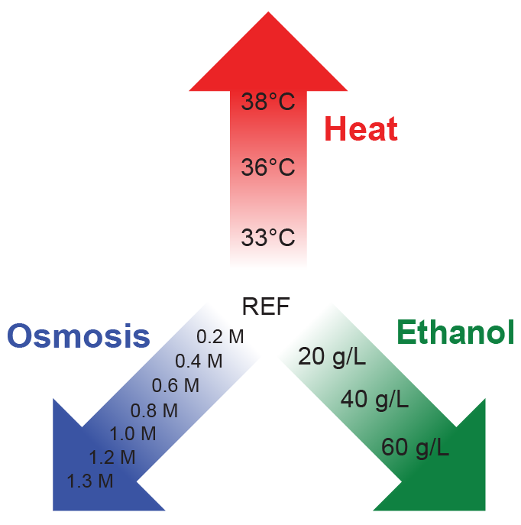
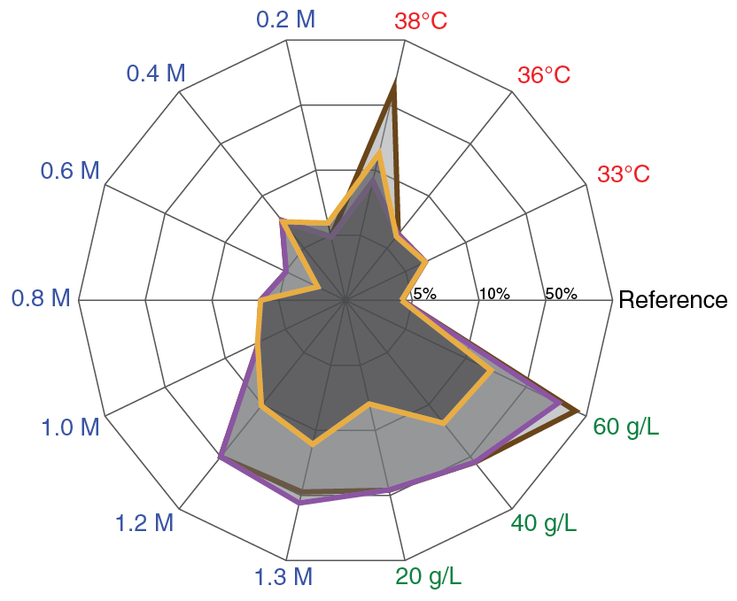
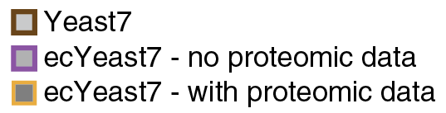
Integrating proteomics
Stress dataset:
S. cerevisiae grown at 14 different stress conditions
Glucose-limited aerobic chemostats @ 0.1 1/h
Proteomic data gathered for each condition
Created condition-specific models:
Error [%] in predicting exchange fluxes:
Notes:
Fitted NGAMs:
Ref: 1 – 1 – 1
33C: 1 – 1 – 1
36C: 1 – 1 – 1
38C: 25 – 31 – 10
0.2M: 1 – 1 – 0
0.4M: 0 – 0 – 0
0.6M: 5 – 5 – 5
0.8M: 6 – 6 – 6
1.0M: 11 – 11 – 7
1.2M: 14 – 14 – 8
1.3M: 15 – 27 – 10
20g/L: 1 – 1 – 3
40g/L: 0 – 0 – 5
60g/L: 0 – 23 – 3

Slide 17
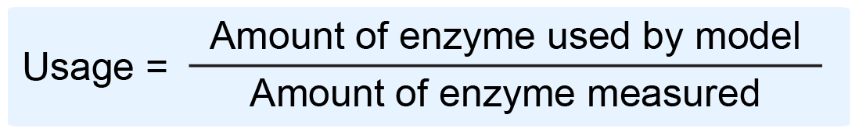
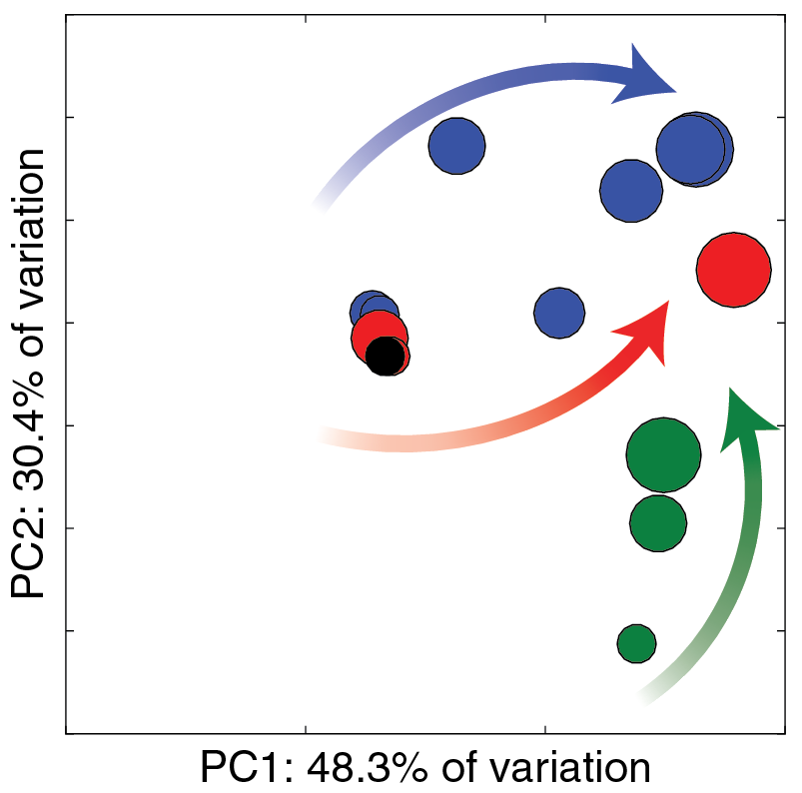
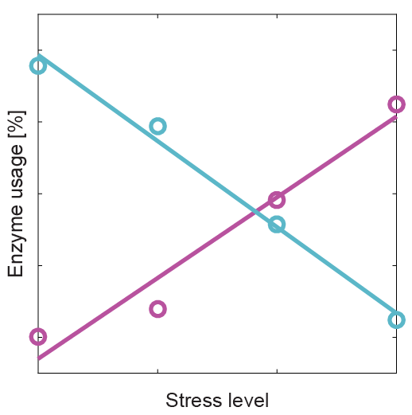
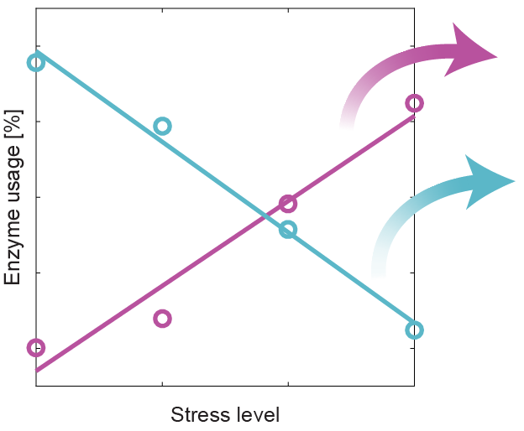
Applications: enzyme usage under stress
Enzyme usage: Can be expressed in absolute terms (mmol/gDW) or as a fraction
General trends
NaCl
Enzyme-specific trends
Increased usage
Heat: LYS21; HIS5; ERG8; ILV3
Osmosis: NDI1; ARO3; CIT1; ILV
Ethanol: MLS1; PYK2; HIS5
Heat
Decreased usage
Heat: GLN4; ADE5,7; UGP1; APA1
Osmosis: ADE5,7; ADE4; ADE2
Ethanol: UGP1
EtOH
Converging trend: Increased CCM and aminoacid degradation
Notes:
Filter: |correlation| > 0.95, m > 0.1, max(usage) > 1%
Increase Heat:
LYS21: L-lysine synthesis (Homocitrate synthase, mitochondrial )
HIS5: L-histidine synthesis (Histidinol-phosphate aminotransferase)
ERG8;13: Ergosterol synthesis (Phosphomevalonate kinase; HMG-CoA synthase)
ILV3;5: L-isoleucine synthesis (Dihydroxy-acid dehydratase; Ketol-acid reductoisomerase)
Decrease Heat:
GLN4: Glutamine--tRNA ligase (ATP + L-glutamine + tRNA(Gln) = AMP + diphosphate + L-glutaminyl-tRNA(Gln))
ADE5,7: IMP biosynthesis via de novo pathway (bifunctional purine biosynthetic protein))
UGP1: carbohydrate synthesis (UTP + alpha-D-glucose 1-phosphate = diphosphate + UDP-glucose)
APA1: ADP + ATP = phosphate + P₁,P(4)-bis(5'-adenosyl) tetraphosphate
Increase Osmosis:
NDI1: “Complex I”, NADH-ubiquinone oxidoreductase, mitochondrial (NADH + ubiquinone = NAD⁺ + ubiquinol)
ARO3: 1st step aromatic synthesis (PEP+ D-ery 4P + H₂O = 3-deoxy-D-arabino-hept-2-ulosonate 7P + P)
CIT1: Citrate synthase (Acetyl-CoA + H₂O + oxaloacetate = citrate + CoA)
ILV2;5: L-isoleucine synthesis (Acetolactate synthase; Ketol-acid reductoisomerase)
Decrease Osmosis:
ADE: IMP biosynthesis via de novo pathway:
ADE2: P-ribosylaminoimidazole carboxylase
ADE4: amido-P-ribosyltransferase
ADE5,7: bifunctional purine biosynthetic protein)
Increase Ethanol:
MLS1: TCA (Malate synthase)
PYK2: Pyruvate kinase (ATP + pyruvate = ADP + PEP)
HIS5: L-histidine synthesis (Histidinol-phosphate aminotransferase)
Decrease Ethanol:
UGP1: carbohydrate synthesis (UTP + alpha-D-glucose 1-phosphate = diphosphate + UDP-glucose)

Slide 18
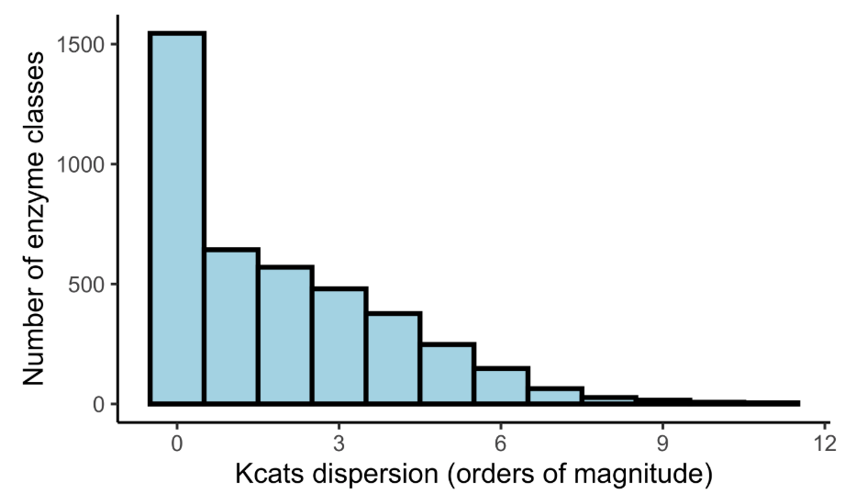
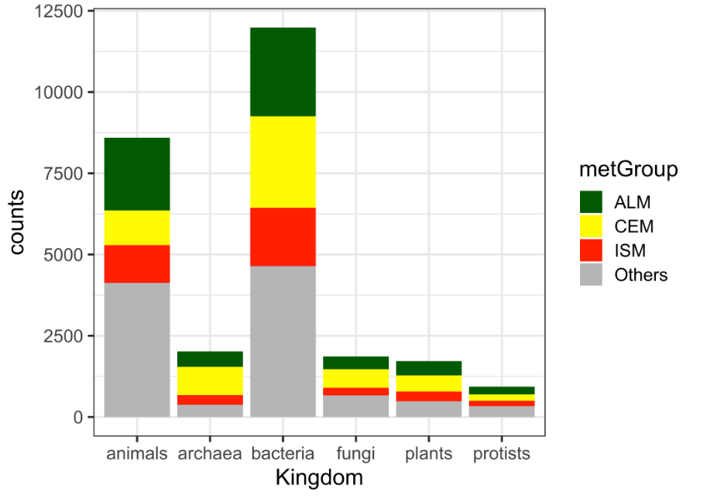

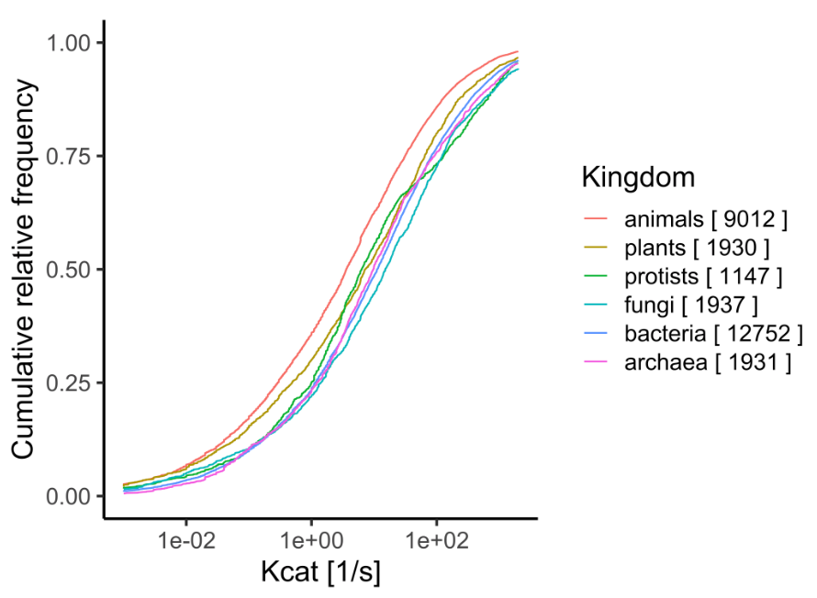
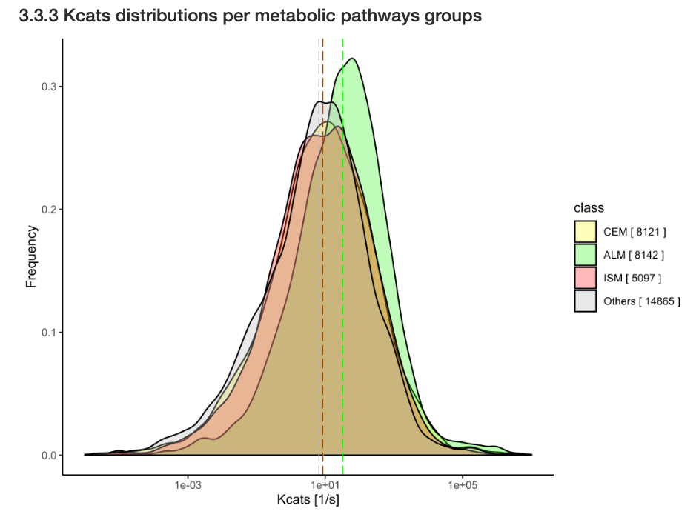
OK for yeast, but what about other bugs?
Notes:
Filter: |correlation| > 0.95, m > 0.1, max(usage) > 1%
Increase Heat:
LYS21: L-lysine synthesis (Homocitrate synthase, mitochondrial )
HIS5: L-histidine synthesis (Histidinol-phosphate aminotransferase)
ERG8;13: Ergosterol synthesis (Phosphomevalonate kinase; HMG-CoA synthase)
ILV3;5: L-isoleucine synthesis (Dihydroxy-acid dehydratase; Ketol-acid reductoisomerase)
Decrease Heat:
GLN4: Glutamine--tRNA ligase (ATP + L-glutamine + tRNA(Gln) = AMP + diphosphate + L-glutaminyl-tRNA(Gln))
ADE5,7: IMP biosynthesis via de novo pathway (bifunctional purine biosynthetic protein))
UGP1: carbohydrate synthesis (UTP + alpha-D-glucose 1-phosphate = diphosphate + UDP-glucose)
APA1: ADP + ATP = phosphate + P₁,P(4)-bis(5'-adenosyl) tetraphosphate
Increase Osmosis:
NDI1: “Complex I”, NADH-ubiquinone oxidoreductase, mitochondrial (NADH + ubiquinone = NAD⁺ + ubiquinol)
ARO3: 1st step aromatic synthesis (PEP+ D-ery 4P + H₂O = 3-deoxy-D-arabino-hept-2-ulosonate 7P + P)
CIT1: Citrate synthase (Acetyl-CoA + H₂O + oxaloacetate = citrate + CoA)
ILV2;5: L-isoleucine synthesis (Acetolactate synthase; Ketol-acid reductoisomerase)
Decrease Osmosis:
ADE: IMP biosynthesis via de novo pathway:
ADE2: P-ribosylaminoimidazole carboxylase
ADE4: amido-P-ribosyltransferase
ADE5,7: bifunctional purine biosynthetic protein)
Increase Ethanol:
MLS1: TCA (Malate synthase)
PYK2: Pyruvate kinase (ATP + pyruvate = ADP + PEP)
HIS5: L-histidine synthesis (Histidinol-phosphate aminotransferase)
Decrease Ethanol:
UGP1: carbohydrate synthesis (UTP + alpha-D-glucose 1-phosphate = diphosphate + UDP-glucose)

Slide 19
OK for yeast, but what about other bugs?
Lessons from BRENDA
K_{cat} values are heterogeneously available and show a extremely high variability amongst organisms and metabolic contexts, limiting the applicability of the original method to other GEMs.
Notes:
Filter: |correlation| > 0.95, m > 0.1, max(usage) > 1%
Increase Heat:
LYS21: L-lysine synthesis (Homocitrate synthase, mitochondrial )
HIS5: L-histidine synthesis (Histidinol-phosphate aminotransferase)
ERG8;13: Ergosterol synthesis (Phosphomevalonate kinase; HMG-CoA synthase)
ILV3;5: L-isoleucine synthesis (Dihydroxy-acid dehydratase; Ketol-acid reductoisomerase)
Decrease Heat:
GLN4: Glutamine--tRNA ligase (ATP + L-glutamine + tRNA(Gln) = AMP + diphosphate + L-glutaminyl-tRNA(Gln))
ADE5,7: IMP biosynthesis via de novo pathway (bifunctional purine biosynthetic protein))
UGP1: carbohydrate synthesis (UTP + alpha-D-glucose 1-phosphate = diphosphate + UDP-glucose)
APA1: ADP + ATP = phosphate + P₁,P(4)-bis(5'-adenosyl) tetraphosphate
Increase Osmosis:
NDI1: “Complex I”, NADH-ubiquinone oxidoreductase, mitochondrial (NADH + ubiquinone = NAD⁺ + ubiquinol)
ARO3: 1st step aromatic synthesis (PEP+ D-ery 4P + H₂O = 3-deoxy-D-arabino-hept-2-ulosonate 7P + P)
CIT1: Citrate synthase (Acetyl-CoA + H₂O + oxaloacetate = citrate + CoA)
ILV2;5: L-isoleucine synthesis (Acetolactate synthase; Ketol-acid reductoisomerase)
Decrease Osmosis:
ADE: IMP biosynthesis via de novo pathway:
ADE2: P-ribosylaminoimidazole carboxylase
ADE4: amido-P-ribosyltransferase
ADE5,7: bifunctional purine biosynthetic protein)
Increase Ethanol:
MLS1: TCA (Malate synthase)
PYK2: Pyruvate kinase (ATP + pyruvate = ADP + PEP)
HIS5: L-histidine synthesis (Histidinol-phosphate aminotransferase)
Decrease Ethanol:
UGP1: carbohydrate synthesis (UTP + alpha-D-glucose 1-phosphate = diphosphate + UDP-glucose)

Slide 20

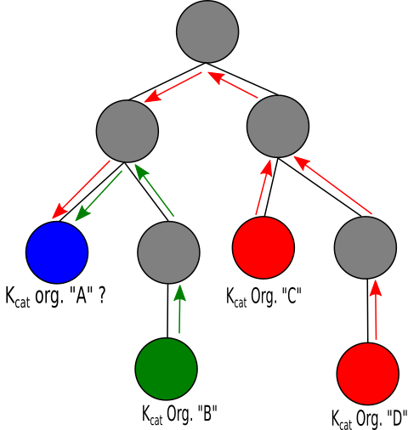
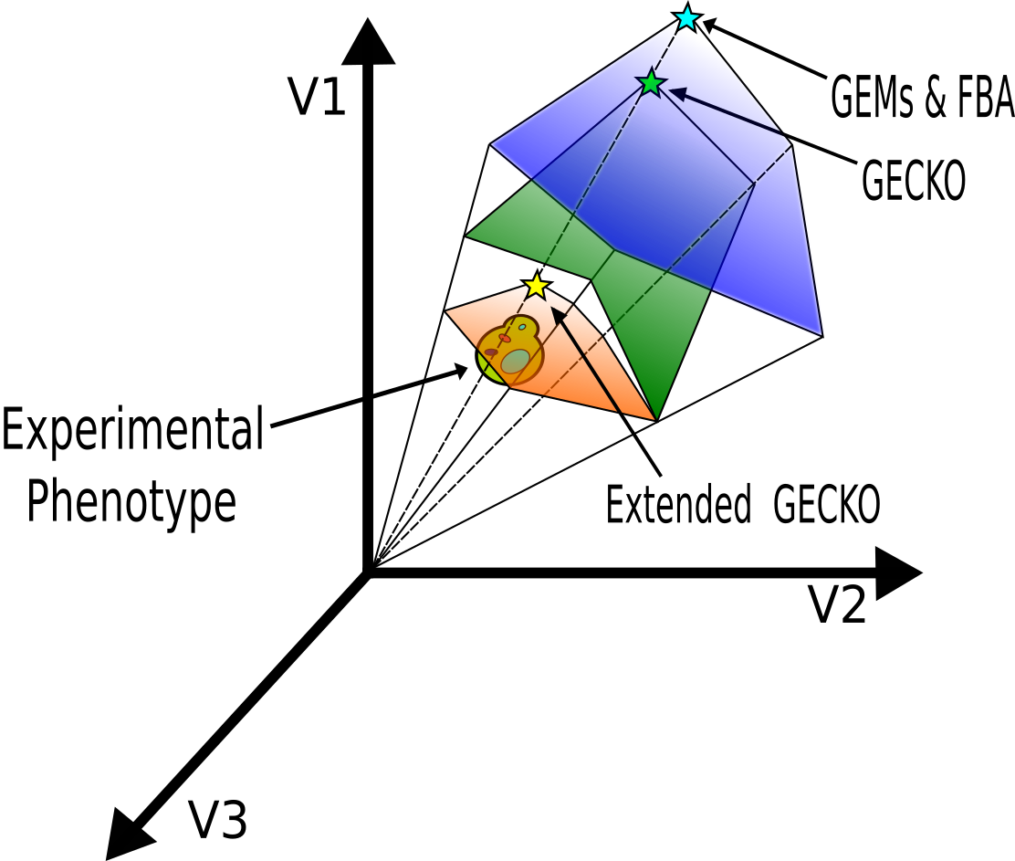

Moving forward
Automatic generation of functional and calibrated ecModel for any organism for which a GEM is available with minimal human intervention
Notes:
Filter: |correlation| > 0.95, m > 0.1, max(usage) > 1%
Increase Heat:
LYS21: L-lysine synthesis (Homocitrate synthase, mitochondrial )
HIS5: L-histidine synthesis (Histidinol-phosphate aminotransferase)
ERG8;13: Ergosterol synthesis (Phosphomevalonate kinase; HMG-CoA synthase)
ILV3;5: L-isoleucine synthesis (Dihydroxy-acid dehydratase; Ketol-acid reductoisomerase)
Decrease Heat:
GLN4: Glutamine--tRNA ligase (ATP + L-glutamine + tRNA(Gln) = AMP + diphosphate + L-glutaminyl-tRNA(Gln))
ADE5,7: IMP biosynthesis via de novo pathway (bifunctional purine biosynthetic protein))
UGP1: carbohydrate synthesis (UTP + alpha-D-glucose 1-phosphate = diphosphate + UDP-glucose)
APA1: ADP + ATP = phosphate + P₁,P(4)-bis(5'-adenosyl) tetraphosphate
Increase Osmosis:
NDI1: “Complex I”, NADH-ubiquinone oxidoreductase, mitochondrial (NADH + ubiquinone = NAD⁺ + ubiquinol)
ARO3: 1st step aromatic synthesis (PEP+ D-ery 4P + H₂O = 3-deoxy-D-arabino-hept-2-ulosonate 7P + P)
CIT1: Citrate synthase (Acetyl-CoA + H₂O + oxaloacetate = citrate + CoA)
ILV2;5: L-isoleucine synthesis (Acetolactate synthase; Ketol-acid reductoisomerase)
Decrease Osmosis:
ADE: IMP biosynthesis via de novo pathway:
ADE2: P-ribosylaminoimidazole carboxylase
ADE4: amido-P-ribosyltransferase
ADE5,7: bifunctional purine biosynthetic protein)
Increase Ethanol:
MLS1: TCA (Malate synthase)
PYK2: Pyruvate kinase (ATP + pyruvate = ADP + PEP)
HIS5: L-histidine synthesis (Histidinol-phosphate aminotransferase)
Decrease Ethanol:
UGP1: carbohydrate synthesis (UTP + alpha-D-glucose 1-phosphate = diphosphate + UDP-glucose)

Slide 21
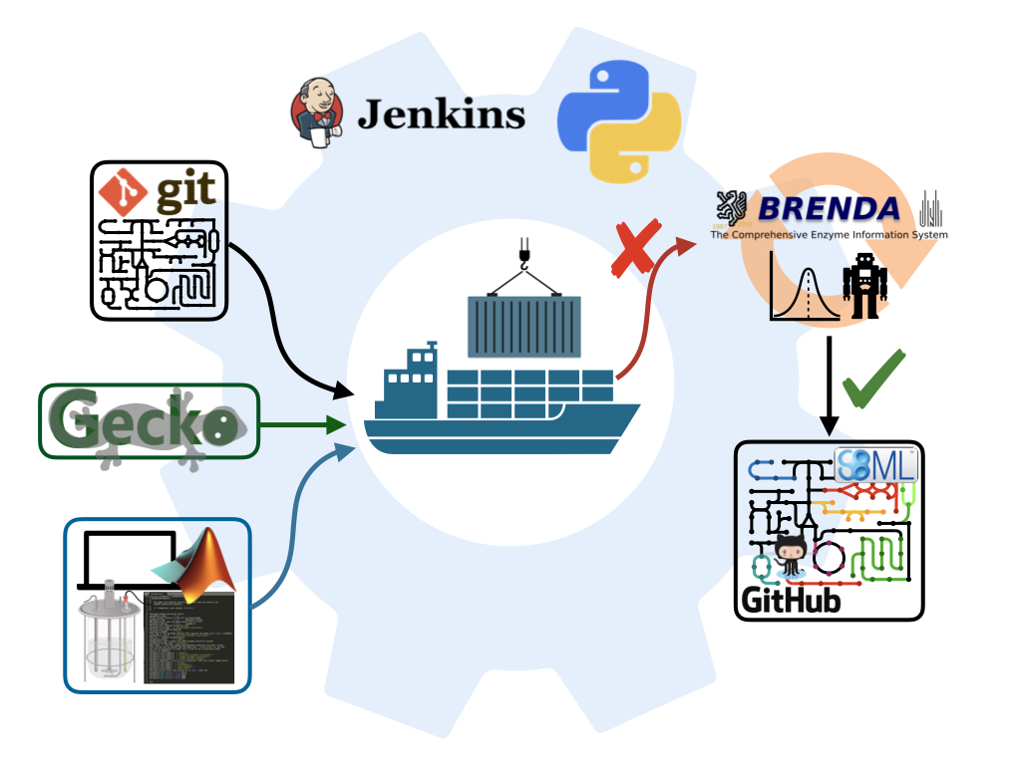
Moving forward: ecModels container
https://github.com/SysBioChalmers/ecModels
Notes:
Filter: |correlation| > 0.95, m > 0.1, max(usage) > 1%
Increase Heat:
LYS21: L-lysine synthesis (Homocitrate synthase, mitochondrial )
HIS5: L-histidine synthesis (Histidinol-phosphate aminotransferase)
ERG8;13: Ergosterol synthesis (Phosphomevalonate kinase; HMG-CoA synthase)
ILV3;5: L-isoleucine synthesis (Dihydroxy-acid dehydratase; Ketol-acid reductoisomerase)
Decrease Heat:
GLN4: Glutamine--tRNA ligase (ATP + L-glutamine + tRNA(Gln) = AMP + diphosphate + L-glutaminyl-tRNA(Gln))
ADE5,7: IMP biosynthesis via de novo pathway (bifunctional purine biosynthetic protein))
UGP1: carbohydrate synthesis (UTP + alpha-D-glucose 1-phosphate = diphosphate + UDP-glucose)
APA1: ADP + ATP = phosphate + P₁,P(4)-bis(5'-adenosyl) tetraphosphate
Increase Osmosis:
NDI1: “Complex I”, NADH-ubiquinone oxidoreductase, mitochondrial (NADH + ubiquinone = NAD⁺ + ubiquinol)
ARO3: 1st step aromatic synthesis (PEP+ D-ery 4P + H₂O = 3-deoxy-D-arabino-hept-2-ulosonate 7P + P)
CIT1: Citrate synthase (Acetyl-CoA + H₂O + oxaloacetate = citrate + CoA)
ILV2;5: L-isoleucine synthesis (Acetolactate synthase; Ketol-acid reductoisomerase)
Decrease Osmosis:
ADE: IMP biosynthesis via de novo pathway:
ADE2: P-ribosylaminoimidazole carboxylase
ADE4: amido-P-ribosyltransferase
ADE5,7: bifunctional purine biosynthetic protein)
Increase Ethanol:
MLS1: TCA (Malate synthase)
PYK2: Pyruvate kinase (ATP + pyruvate = ADP + PEP)
HIS5: L-histidine synthesis (Histidinol-phosphate aminotransferase)
Decrease Ethanol:
UGP1: carbohydrate synthesis (UTP + alpha-D-glucose 1-phosphate = diphosphate + UDP-glucose)

Slide 22
A collection of ecModels
Enzymes coverage varies due to differences in functional annotation.

Slide 23
Reducing the solution space - FVA
-Median flux variability reduced in orders magnitude
-Number of totally variable fluxes is drastically reduced

Slide 24
Reducing the solution space - FVA
K. marxianus
1
-
0.75
Model
ecModel
0.5
0.25
0
10⁻²
10⁰
10²

Slide 25
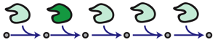
Applications: exploring mutant phenotypes
Gene deletions
Gene overexpressions
ecModels provide a natural framework for the exploration of enzymes deletion and overexpression effects on metabolism

Slide 26

Applications: exploring mutant phenotypes
Complex enzyme(s)-rxn(s) relationships are taken into account
Optimal expression levels for production targets can be assessed.
Gene deletions
Gene overexpressions

Slide 27
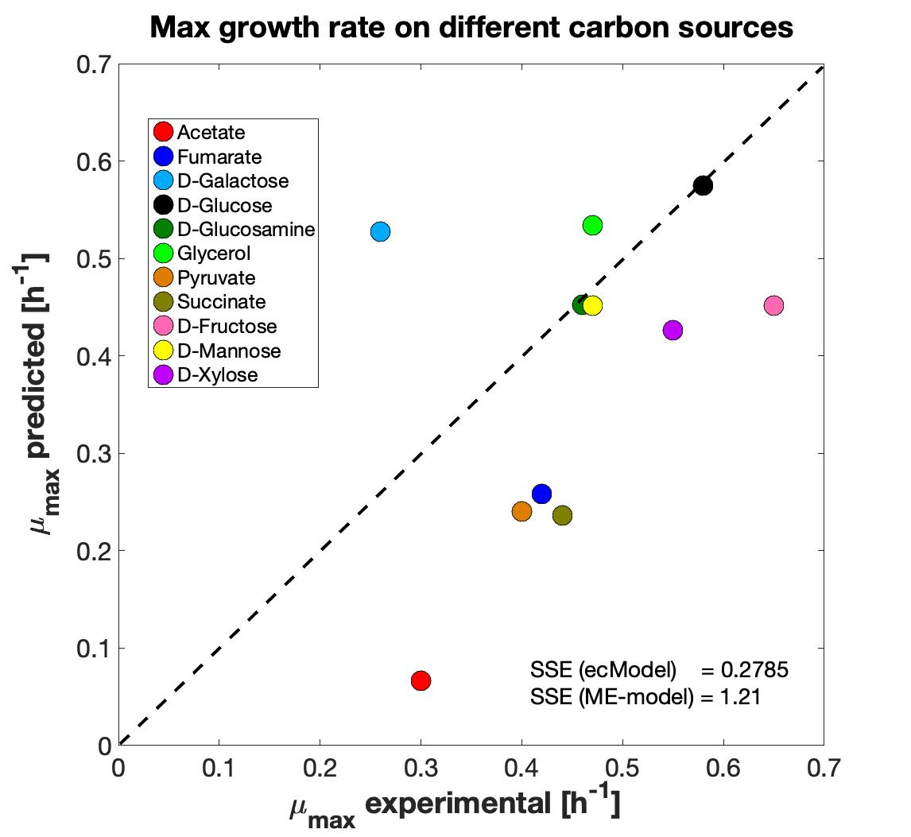
Applications: growth on diverse environments
E. coli
S. cerevisiae
E. coli
Total protein prediction
[g prot/gDw]
ecModels protein allocation compared to ME models
Growth predictions on diverse environments

Slide 28
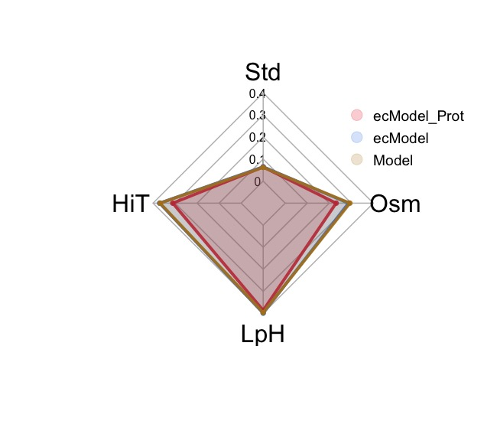
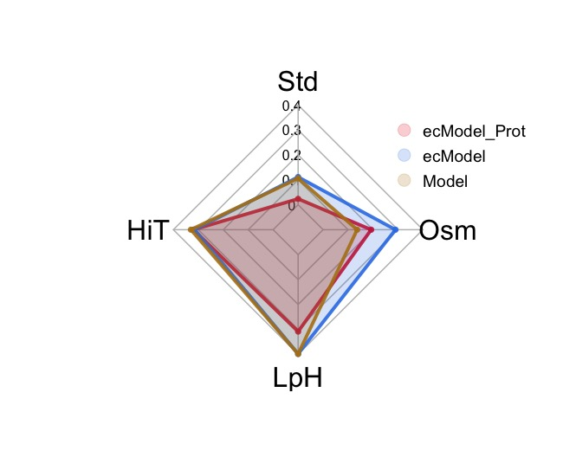
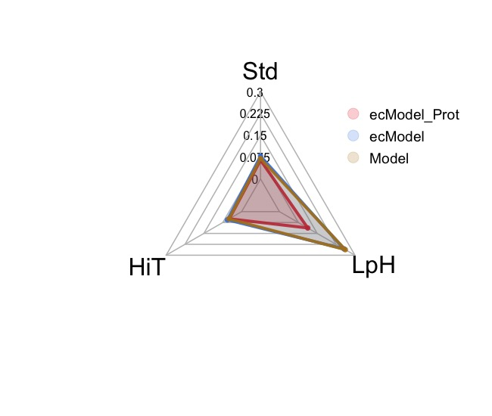
Applications: analyzing stress responses
Improving phenotype predictions by the addition of proteomics data for multiple conditions
S. cerevisiae
K. marxianus
Y. lipolytica
*Median relative error in exchange fluxes prediction

Slide 29
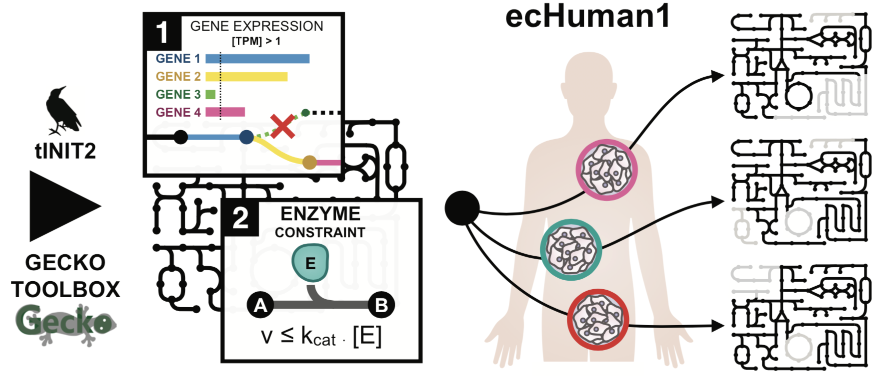
Applications: exploring Human metabolism
Generation of 11 human cell-lines ecModels through the incorporation of transcriptomics data and kinetic constraints

Slide 30
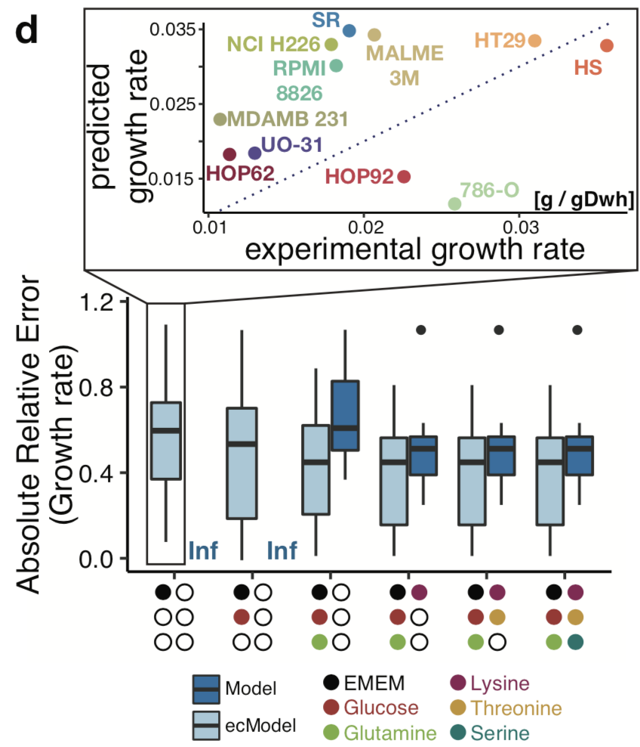
Applications: exploring Human metabolism
Generation of 11 human cell-lines ecModels through the incorporation of transcriptomics data and kinetic constraints
Predicting growth rates with minimal sets of exchange fluxes constraints

Slide 31

Summary
Protein limitation: Common among many experimental conditions. Important to model!
: A simple method for improving GEM predictions in
Enzyme usage: Useful for finding enzymes with an important role in metabolism

Slide 32



Our computational tools are available at:
https://github.com/SysBioChalmers/GECKO
https://github.com/SysBioChalmers/ecModels
Contributions are very welcome!

